Slide 1
PROBABILITY AND STATISTICS PROJECT
TOPIC OF PROJECT: HEART DISEASE PREDICTION
SOFTWARE USED: RStudio

Slide 2
TEAM MEMBERS
REG. NO. | NAME
21BCE5724 | SUGANDHI NINAD NILESH
21BCE5726 | DUNNA SRAVAN KUMAR
21BCE5733 | AMAN ANAND
21BCE5871 | RAJEEV RANJAN

Slide 3
Table of contents
01
Basic Statistical Analysis
04
Multiple Linear Regression
Using lm function for predicting output
Consists of basic analysis functions such as mean, median, mode, etc.
05
Logistic Regression
02
Data Visualization
Using glm function for predicting output
Visualization of data using plots, histogram, etc
06
Prediction Using Plots
03
Correlation
Correlation between members of data items.
Using plots function for plotting between prediction and actual values

Slide 4
https://drive.google.com/file/d/1tdbow15rjD-0egVGK4IrgBsk081OZ_Xn/view?usp=sharing
LINK OF UPLOADED DATASET TAKEN FROM KAGGLE PASTED BELOW

Slide 5
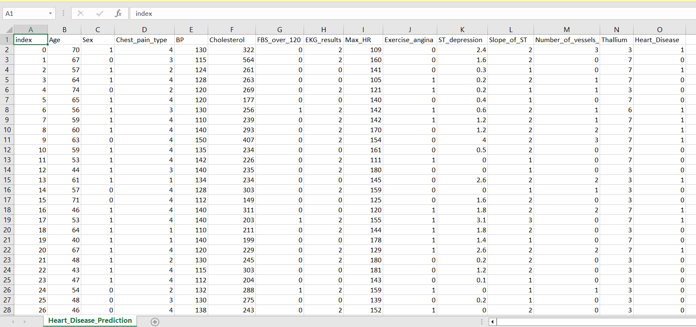
SCREENSHOT OF DATASET

Slide 6
BASIC STATISTICAL ANALYSIS
01

Slide 7
MEAN
attach(Heart_Disease_Prediction)
mean(Age)
[1] 54.43333
mean(Chest_pain_type)
[1] 3.174074
mean(BP)
[1] 131.3444
mean(Cholesterol)
[1] 249.6593
mean(FBS_over_120)
[1] 0.1481481
mean(Max_HR)
[1] 149.6778
mean(ST_depression)
[1] 1.05
mean(Slope_of_ST)
[1] 1.585185
mean(Thallium)
[1] 4.696296

Slide 8
MEDIAN
median(Age)
[1] 55
median(BP)
[1] 130
median(Cholesterol)
[1] 245
median(Max_HR)
[1] 153.5
median(ST_depression)
[1] 0.8
median(Thallium)
[1] 3

Slide 9
MODE
my_mode <- function(x) { # Create mode function
+ unique_x <- unique(x)
+ tabulate_x <- tabulate(match(x, unique_x))
+ unique_x[tabulate_x == max(tabulate_x)]
+ }
my_mode(Age)
[1] 54
my_mode(Sex)
[1] 1
print("This defines that number of men is not equal to number of women")
[1] "This defines that number of men is not equal to number of women“
my_mode(Chest_pain_type)
[1] 4
print("Most of the people have the chest pain of 4th type")
[1] "Most of the people have the chest pain of 4th type“
my_mode(BP)
[1] 120
print("120 is the most repeated among the recorded BP in the dataset")
[1] "120 is the most repeated among the recorded BP in the dataset“
my_mode(Cholesterol)
[1] 234

Slide 10
MODE (CONTINUED)
print("234 is the most repeated value of cholestrol recorded among the patients")
[1] "234 is the most repeated value of cholestrol recorded among the patients“
my_mode(Max_HR)
[1] 162
my_mode(Thallium)
[1] 3
print("3 units of thallium is present in most of the patients body")
[1] "3 units of thallium is present in most of the patients body"> my_mode(Heart_Disease)
[1] 0
print("Number of Patients having Heart Disease is less than number of patients not suffering from any Heart Disease")
[1] "Number of Patients having Heart Disease is less than number of patients not suffering from any Heart Disease"

Slide 11
SUMMARY
summary(Age)
Min. 1st Qu. Median Mean 3rd Qu. Max.
29.00 48.00 55.00 54.43 61.00 77.00
summary(Sex)
Min. 1st Qu. Median Mean 3rd Qu. Max.
0.0000 0.0000 1.0000 0.6778 1.0000 1.0000
summary(Chest_pain_type)
Min. 1st Qu. Median Mean 3rd Qu. Max.
1.000 3.000 3.000 3.174 4.000 4.000
summary(BP)
Min. 1st Qu. Median Mean 3rd Qu. Max.
94.0 120.0 130.0 131.3 140.0 200.0
summary(Cholesterol)
Min. 1st Qu. Median Mean 3rd Qu. Max.
126.0 213.0 245.0 249.7 280.0 564.0

Slide 12
SUMMARY CONTINUED
summary(FBS_over_120)
Min. 1st Qu. Median Mean 3rd Qu. Max.
0.0000 0.0000 0.0000 0.1481 0.0000 1.0000
summary(EKG_results)
Min. 1st Qu. Median Mean 3rd Qu. Max.
0.000 0.000 2.000 1.022 2.000 2.000
summary(Max_HR)
Min. 1st Qu. Median Mean 3rd Qu. Max.
71.0 133.0 153.5 149.7 166.0 202.0
summary(Exercise_angina)
Min. 1st Qu. Median Mean 3rd Qu. Max.
0.0000 0.0000 0.0000 0.3296 1.0000 1.0000

Slide 13
SUMMARY CONTINUED
summary(ST_depression)
Length Class Mode
1 character character
summary(Slope_of_ST)
Min. 1st Qu. Median Mean 3rd Qu. Max.
1.000 1.000 2.000 1.585 2.000 3.000
summary(Number_of_vessels_fluro)
Min. 1st Qu. Median Mean 3rd Qu. Max.
0.0000 0.0000 0.0000 0.6704 1.0000 3.0000
summary(Thallium)
Min. 1st Qu. Median Mean 3rd Qu. Max.
3.000 3.000 3.000 4.696 7.000 7.000

Slide 14
VARIANCE & STANDARD DEVIATION
var(Age)
[1] 82.97509
sd(Age)
[1] 9.109067
var(BP)
[1] 319.0371
sd(BP)
[1] 17.86161
var(Cholesterol)
[1] 2671.467
sd(Cholesterol)
[1] 51.68624
var(Max_HR)
[1] 536.6504
sd(Max_HR)
[1] 23.16572

Slide 15
COVARIANCE
cov1 = cov(Age, BP)
Cov1
[1] 44.42639
cov2 = cov(Sex, BP)
Cov2
[1] -0.5242875
cov3 = cov(BP, Cholesterol)
Cov3
[1] 159.7312
cov(Age, Heart_Disease)
[1] 0.9628253
cov(Sex, Heart_Disease)
[1] 0.06939281
cov(Chest_pain_type, Heart_Disease)
[1] 0.1974391
cov(BP, Heart_Disease)
[1] 1.38166
cov(Cholesterol, Heart_Disease)

Slide 16
COVARIANCE CONTINUED
[1] 3.036762
cov(FBS_over_120, Heart_Disease)
[1] -0.002891367
cov(EKG_results, Heart_Disease)
[1] 0.09045849
cov(Max_HR, Heart_Disease)
[1] -4.826518
cov(Exercise_angina, Heart_Disease)
[1] 0.09830648
cov(ST_depression, Heart_Disease)
[1] 0.23829
cov(Slope_of_ST, Heart_Disease)
[1] 0.1032631
cov(Number_of_vessels_fluro, Heart_Disease)
[1] 0.2139612
cov(Thallium, Heart_Disease)
[1] 0.5072284

Slide 17
DATA VISUALIZATION
02

Slide 18
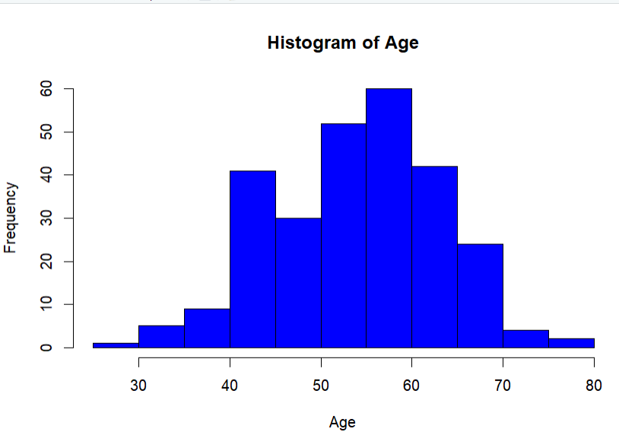
HISTOGRAM
> hist(Age, col = ‘blue’)

Slide 19
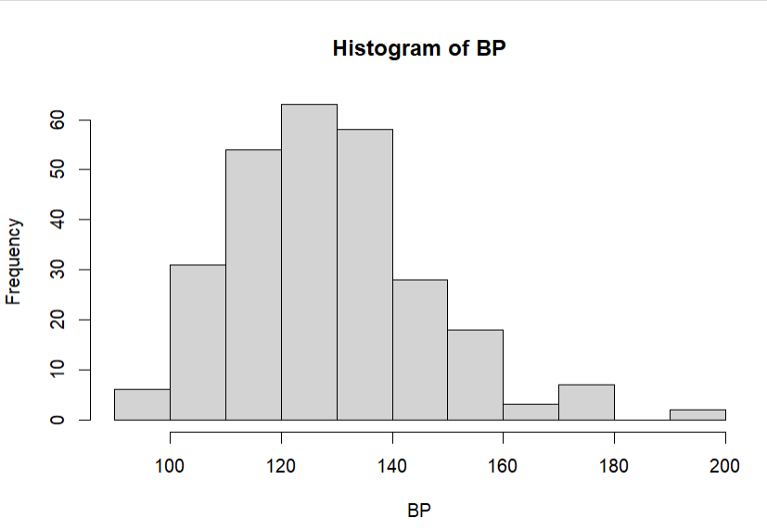
HISTOGRAM CONTINUED
> hist(BP)

Slide 20
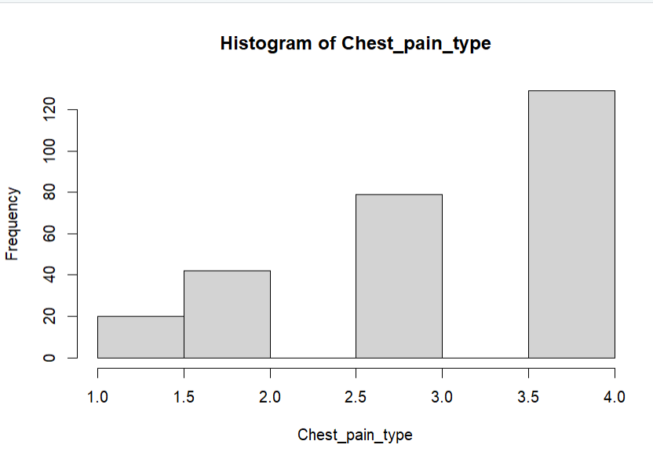
HISTOGRAM CONTINUED
> hist(Chest_pain_type)

Slide 21
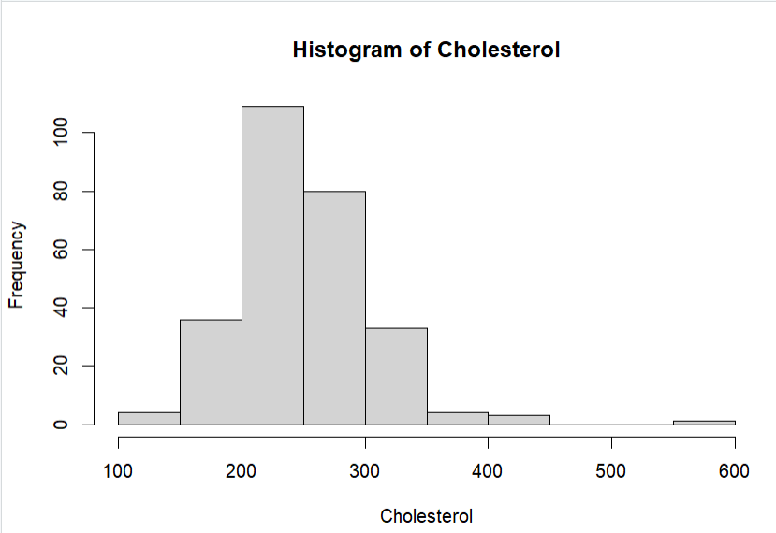
HISTOGRAM CONTINUED
> hist(Cholesterol)

Slide 22
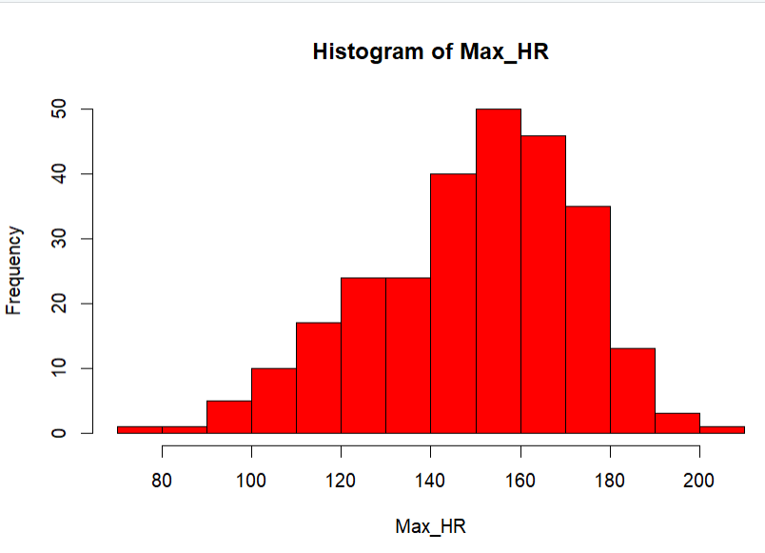
HISTOGRAM CONTINUED
> hist(Max_HR, col = 'red')

Slide 23
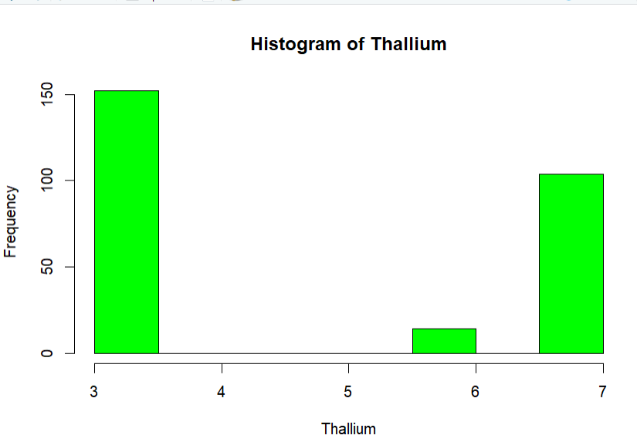
HISTOGRAM CONTINUED
> hist(Thallium, col = 'green')

Slide 24
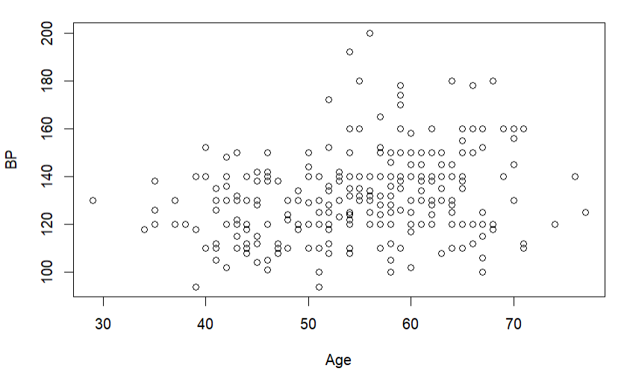
PLOT
> plot(Age,BP)

Slide 25
CORRELATION
03

Slide 26
cor.test(Age, Heart_Disease)
Pearson's product-moment correlation
data: Age and Heart_Disease
t = 3.557, df = 268, p-value = 0.0004435
alternative hypothesis: true correlation is not equal to 0
95 percent confidence interval:
0.09536339 0.32349863
sample estimates:
cor
0.2123222
cor.test(Sex, Heart_Disease)
Pearson's product-moment correlation
data: Sex and Heart_Disease
t = 5.1054, df = 268, p-value = 6.267e-07
alternative hypothesis: true correlation is not equal to 0
95 percent confidence interval:
0.1849169 0.4027815
sample estimates:
cor
0.2977208

Slide 27
cor.test(Chest_pain_type, Heart_Disease)
Pearson's product-moment correlation
data: Chest_pain_type and Heart_Disease
t = 7.5203, df = 268, p-value = 8.262e-13
alternative hypothesis: true correlation is not equal to 0
95 percent confidence interval:
0.3136922 0.5113315
sample estimates:
cor
0.4174362
cor.test(BP, Heart_Disease)
Pearson's product-moment correlation
data: BP and Heart_Disease
t = 2.575, df = 268, p-value = 0.01056
alternative hypothesis: true correlation is not equal to 0
95 percent confidence interval:
0.03668728 0.26975488
sample estimates:
cor
0.1553827

Slide 28
cor.test(Cholesterol, Heart_Disease)
Pearson's product-moment correlation
data: Cholesterol and Heart_Disease
t = 1.9457, df = 268, p-value = 0.05274
alternative hypothesis: true correlation is not equal to 0
95 percent confidence interval:
-0.001374728 0.234098256
sample estimates:
cor
0.1180205
cor.test(FBS_over_120, Heart_Disease)
Pearson's product-moment correlation
data: FBS_over_120 and Heart_Disease
t = -0.26719, df = 268, p-value = 0.7895
alternative hypothesis: true correlation is not equal to 0
95 percent confidence interval:
-0.1354309 0.1032582
sample estimates:
cor
-0.01631883

Slide 29
cor.test(EKG_results, Heart_Disease)
Pearson's product-moment correlation
data: EKG_results and Heart_Disease
t = 3.0316, df = 268, p-value = 0.00267
alternative hypothesis: true correlation is not equal to 0
95 percent confidence interval:
0.06410841 0.29505301
sample estimates:
cor
0.1820908
cor.test(Max_HR, Heart_Disease)
Pearson's product-moment correlation
data: Max_HR and Heart_Disease
t = -7.5438, df = 268, p-value = 7.12e-13
alternative hypothesis: true correlation is not equal to 0
95 percent confidence interval:
-0.5122953 -0.3148691
sample estimates:
cor
-0.418514

Slide 30
cor.test(Exercise_angina, Heart_Disease)
Pearson's product-moment correlation
data: Exercise_angina and Heart_Disease
t = 7.5611, df = 268, p-value = 6.383e-13
alternative hypothesis: true correlation is not equal to 0
95 percent confidence interval:
0.3157306 0.5130005
sample estimates:
cor
0.4193027
cor.test(ST_depression, Heart_Disease)
Pearson's product-moment correlation
data: ST_depression and Heart_Disease
t = 7.5319, df = 268, p-value = 7.678e-13
alternative hypothesis: true correlation is not equal to 0
95 percent confidence interval:
0.3142722 0.5118066
sample estimates:
Cor
0.4179674

Slide 31
cor.test(Slope_of_ST, Heart_Disease)
Pearson's product-moment correlation
data: Slope_of_ST and Heart_Disease
t = 5.8718, df = 268, p-value = 1.272e-08
alternative hypothesis: true correlation is not equal to 0
95 percent confidence interval:
0.2274052 0.4392872
sample estimates:
cor
0.337616
cor.test(Number_of_vessels_fluro, Heart_Disease)
Pearson's product-moment correlation
data: Number_of_vessels_fluro and Heart_Disease
t = 8.3725, df = 268, p-value = 3.173e-15
alternative hypothesis: true correlation is not equal to 0
95 percent confidence interval:
0.3552718 0.5450837
sample estimates:
cor
0.4553365

Slide 32
cor.test(Thallium, Heart_Disease)
Pearson's product-moment correlation
data: Thallium and Heart_Disease
t = 10.099, df = 268, p-value < 2.2e-16
alternative hypothesis: true correlation is not equal to 0
95 percent confidence interval:
0.4327681 0.6063908
sample estimates:
cor
0.5250203

Slide 33
Multiple Linear Regression
04

Slide 34
fit1 = lm(Heart_Disease~BP + Age + Sex + Thallium)
fit1
Call:
lm(formula = Heart_Disease ~ BP + Age + Sex + Thallium)
Coefficients:
(Intercept) BP Age Sex Thallium
-0.900582 0.001716 0.008852 0.152465 0.113803

Slide 35
fit1 = lm(BP ~ Age + Sex + Chest_pain_type + FBS_over_120 + EKG_results + Max_HR + Exercise_angina + ST_depression + Slope_of_ST + Number_of_vessels_fluro + Thallium)
fit1
Call:
lm(formula = BP ~ Age + Sex + Chest_pain_type + FBS_over_120 + EKG_results + Max_HR + Exercise_angina + ST_depression + Slope_of_ST + Number_of_vessels_fluro + Thallium)
Coefficients:
(Intercept) Age Sex
83.8148 0.5267 -4.1680
Chest_pain_type FBS_over_120 EKG_results
-1.7281 5.9246 1.3346
Max_HR Exercise_angina ST_depression
0.1108 2.7272 3.1902
Slope_of_ST Number_of_vessels_fluro Thallium
-0.5168 -1.1262 1.2081
reached 'max' / getOption("max.print") -- omitted 204 rows ]

Slide 36
Logistic Regression
05

Slide 37
fit2 = glm(Heart_Disease ~ Age + Sex + Chest_pain_type + BP + Cholesterol + FBS_over_120 + EKG_results + Max_HR + Exercise_angina + ST_depression + Slope_of_ST + Number_of_vessels_fluro + Thallium, data = data, family = binomial(link = 'logit’))
summary(fit2)
Call:
glm(formula = Heart_Disease ~ Age + Sex + Chest_pain_type + BP + Cholesterol + FBS_over_120 + EKG_results + Max_HR + Exercise_angina + ST_depression + Slope_of_ST + Number_of_vessels_fluro + Thallium, family = binomial(link = "logit"), data = data)
Deviance Residuals:
Min 1Q Median 3Q Max
-2.6123 -0.5120 -0.1739 0.4023 2.4210
Coefficients:
Estimate Std. Error z value Pr(>|z|)
(Intercept) -8.446417 3.088097 -2.735 0.00624 **
Age -0.017477 0.025720 -0.680 0.49681
Sex 1.542109 0.540762 2.852 0.00435 **

Slide 38
Chest_pain_type 0.700895 0.215280 3.256 0.00113 **
BP 0.025216 0.011450 2.202 0.02765 *
Cholesterol 0.007228 0.004077 1.773 0.07628 .
FBS_over_120 -0.794811 0.574662 -1.383 0.16664
EKG_results 0.301668 0.197838 1.525 0.12730
Max_HR -0.021045 0.010579 -1.989 0.04666 *
Exercise_angina 0.829386 0.431091 1.924 0.05436 .
ST_depression 0.343690 0.227068 1.514 0.13013
Slope_of_ST 0.442276 0.391077 1.131 0.25809
Number_of_vessels_fluro 1.165271 0.269283 4.327 1.51e-05 ***
Thallium 0.341384 0.106066 3.219 0.00129 **
---
Signif. codes: 0 ‘***’ 0.001 ‘**’ 0.01 ‘*’ 0.05 ‘.’ 0.1 ‘ ’ 1
(Dispersion parameter for binomial family taken to be 1)
Null deviance: 370.96 on 269 degrees of freedom
Residual deviance: 179.60 on 256 degrees of freedom
AIC: 207.6
Number of Fisher Scoring iterations: 6

Slide 39
> predict_regression = predict(fit2, data, type = 'response’)
> predict_regression
1 2 3 4 5 6 7
0.991998619 0.627598571 0.179790533 0.954226458 0.144175093 0.287328023 0.786154238
8 9 10 11 12 13 14
0.934964448 0.971845881 0.995878630 0.505348858 0.892430729 0.113024750 0.470539572
15 16 17 18 19 20 21
0.208746590 0.040909142 0.995507390 0.893626135 0.109723983 0.176905386 0.990297874
22 23 24 25 26 27 28
0.075866594 0.222628921 0.106010724 0.065691610 0.035331466 0.255772844 0.042899619
29 30 31 32 33 34 35
0.750430000 0.039501130 0.751857127 0.803520602 0.010753215 0.992479545 0.921771902
36 37 38 39 40 41 42

Slide 40
0.944402505 0.954274292 0.143356380 0.066178379 0.108771869 0.417657619 0.017074168
43 44 45 46 47 48 49
0.125400301 0.027075692 0.539786437 0.049383376 0.829665235 0.238294968 0.979949088
50 51 52 53 54 55 56
0.981066996 0.932240375 0.007371878 0.178814730 0.040073054 0.021324125 0.010087727
57 58 59 60 61 62 63
0.932523472 0.011790340 0.319069745 0.861428506 0.186275875 0.616813096 0.047361787
64 65 66 67 68 69 70
0.006059465 0.241091018 0.983049517 0.356493518 0.128239900 0.087324301 0.053363024

Slide 41
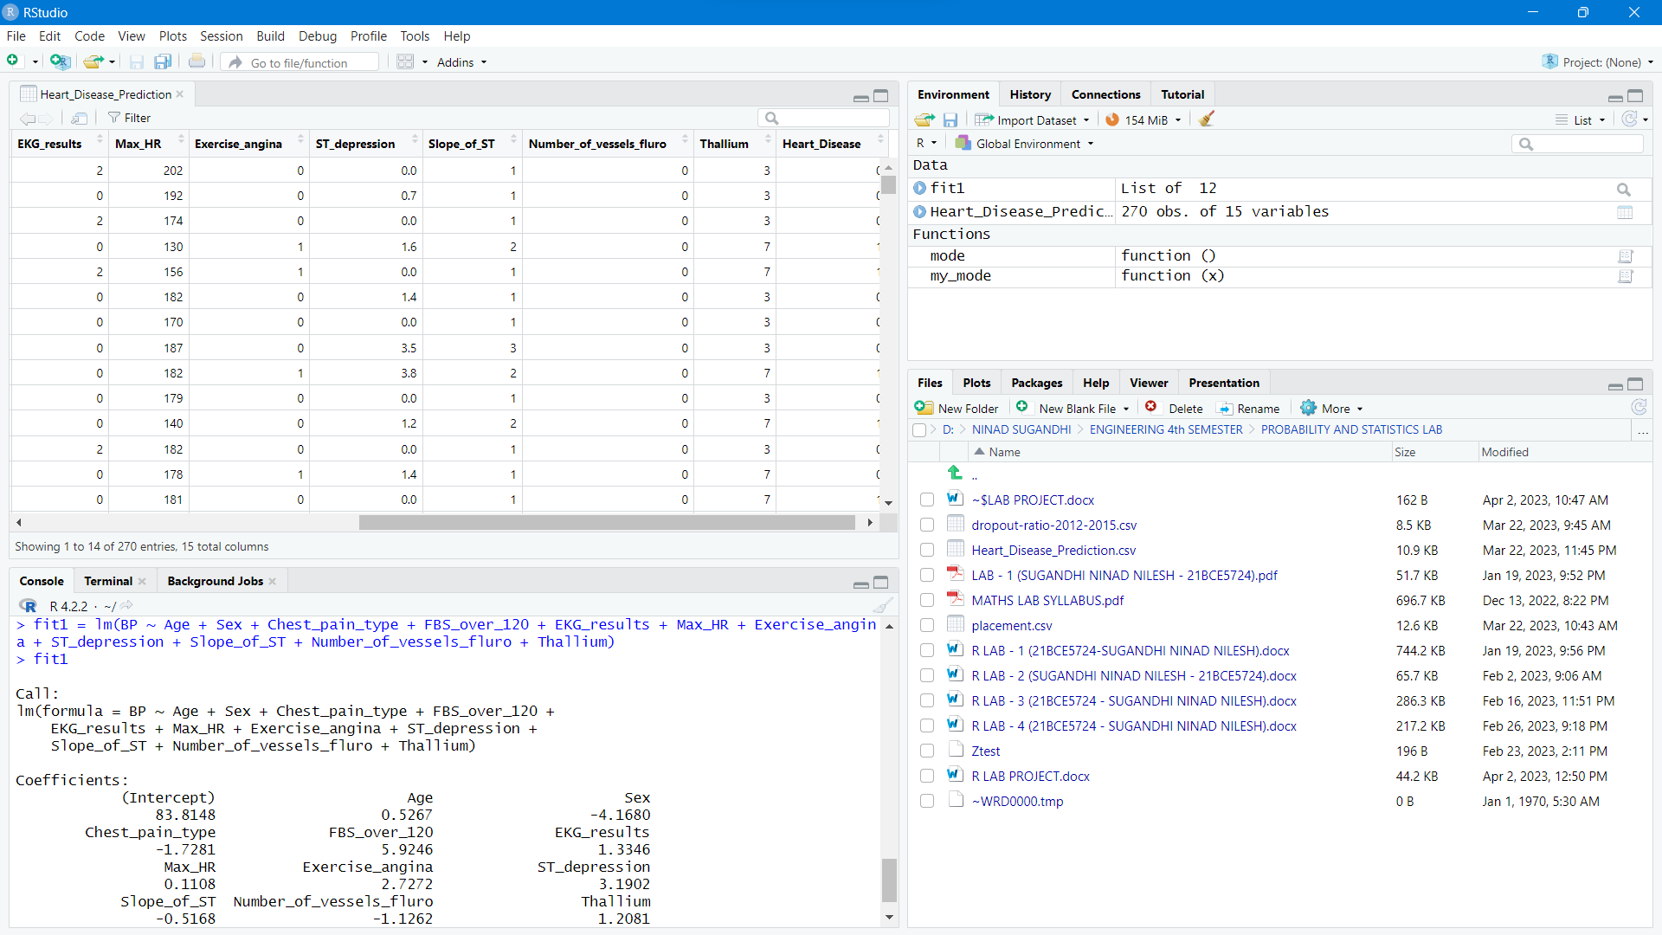

Slide 42
Prediction Using Plots
06

Slide 43
par(mfrow = c(3,4))
plot(Age, predict_regression, main = "Age", col = rgb(red = 0.5, blue = 0.2, green = 0.8))
plot(Sex, predict_regression, main = "Sex", col = rgb(red = 0.6, blue = 0.3, green = 0.2))
plot(Chest_pain_type, predict_regression, main = "Chest pain type", col = rgb(red = 0.2, blue = 0.4, green = 0.6))
plot(BP, predict_regression, main = "Blood Pressure", col = rgb(red = 0.5, blue = 0.2, green = 0.7))
plot(Cholesterol, predict_regression, main = "Cholestrol", col = rgb(red = 0.4, blue = 0.8, green = 0.2))
plot(FBS_over_120, predict_regression, main = "FBS over 120", col = rgb(red = 0.2, blue = 0.6, green = 0.1))
plot(EKG_results, predict_regression, main = "EKG results", col = rgb(red = 0.2, blue = 0.6, green = 0.1))
plot(Max_HR, predict_regression, main = "Max HR", col = rgb(red = 0.5, blue = 0.6, green = 0.6))
plot(Exercise_angina, predict_regression, main = "Exercise Angina", col = rgb(red = 0.5, blue = 0.5, green = 0.5))
plot(ST_depression, predict_regression, main = "ST depression", col = rgb(red = 0.8, blue = 0.2, green = 0.2))
plot(Number_of_vessels_fluro, predict_regression, main = "Number of vessels of fluro", col = rgb(red = 0.1, blue = 0.8, green = 0.4))
plot(Thallium, predict_regression, main = "Thallium", col = rgb(red = 0.1, blue = 0.8, green = 0.8))

Slide 44
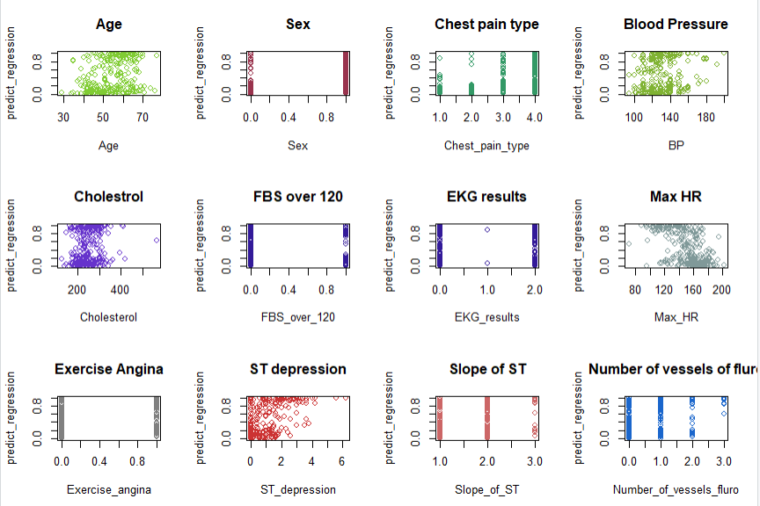
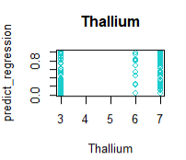

Slide 45
Thanks

